Slide 1


Update on Drinking Water Discharge Practices by Two Utilities Covered by the Statewide General Permit for Drinking Water Discharges NPDES Permit
Francois Rodigari, Director of Water Quality and Environmental Services, SJW
Mark Bloom, Environmental Affairs Program Manager, California Water Service

Slide 2
Outline
Operational Changes Related to Compliance with Statewide General NPDES for DWS Discharges
Examples of BMPs Used for Permitted Discharges
Examples of Administrative BMPs
Status of the Revised CA-NV BMPs Manual
Notes:
Potable Water Discharges Compliance for Water Utilities without an NPDES Permit.
Many water utilities in the San Francisco Bay Area, public and investor owned, have not been directly permitted to discharge potable water into stormwater conveyance systems or navigable waters of the U.S. These unpermitted utilities have been operating under an exemption of the San Francisco Bay Municipal Regional Stormwater Permit even though they were not permittees. This arrangement of compliance under the umbrella of another agency’s permit had worked well until it was called into question when a utility was cited for discharging without a permit by the San Francisco Bay Regional Water Quality Control Board (Water Board).
When the Water Board was asked to develop a new permit by the utilities, the Water Board requested financial assistance to fund a contract position for writing a proposed potable water discharge permit. Eight utilities agreed to share the cost of funding this permit writing effort, with East Bay Municipal Utilitiy District (EBMUD) serving as the lead agency. A funding contract between the agencies and EBMUD as well a contract between EBMUD and the Association of Bay Area Governments, acting as the manager for the contract Water Board permit writer, were signed in April 2012.
The writing of the permit has been a collaborative process between the funding agencies and the contract permit writer. Field visits have been hosted for the permit writer by most of the funding agencies. These visits were performed under a no enforcement understanding and were designed to give an accurate representation to the permit writer of the agencies’ operational needs and field challenges encountered during unplanned discharges. The visits and discussions among the eight agencies have led to a better understanding and agreement among all the parties on what can be reasonably achieved using commonly accepted Best Management Practices (BMPs) and has also identified ways to improve communication and reporting between the Board and the agencies.

Slide 3
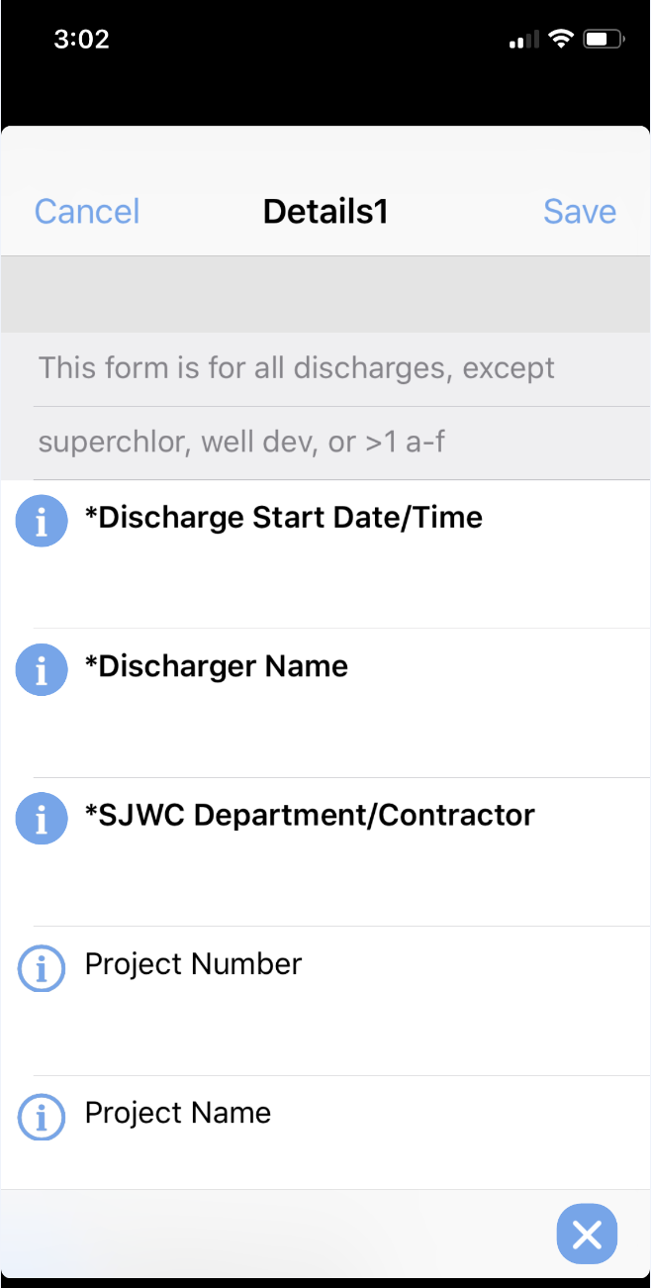
Operational Changes at SJW
Developed a mobile data acquisition application to capture information about unplanned and planned discharges
Updated and developed new SOPs
Performed staff and contractors training
Reviewed and improved activities specific BMPs

Slide 4
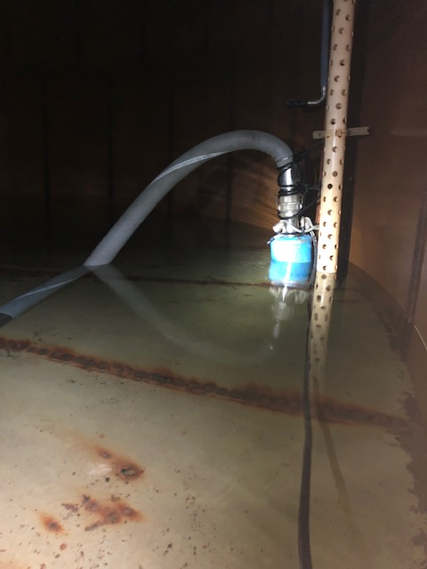
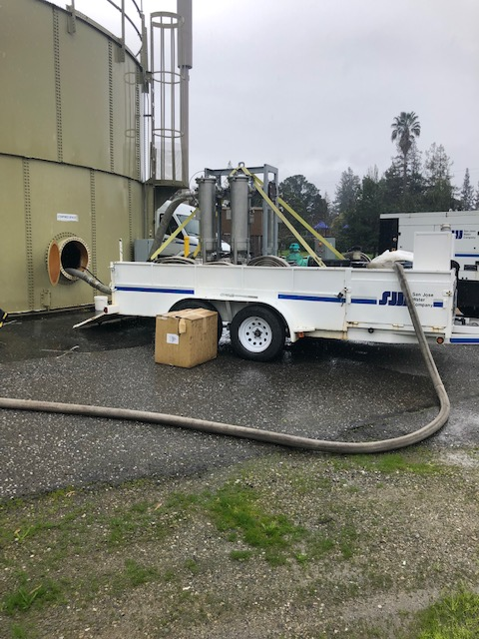
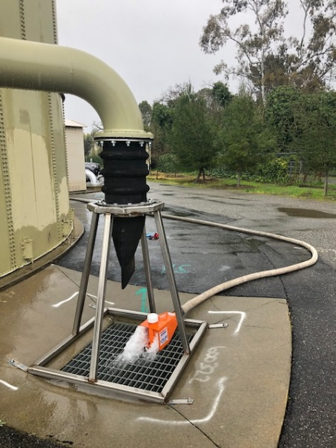
Tank Dewatering & Cleaning
Bottom of tank is filtered through a 1µm filter
Captured sediments are characterized prior to disposal

Slide 5
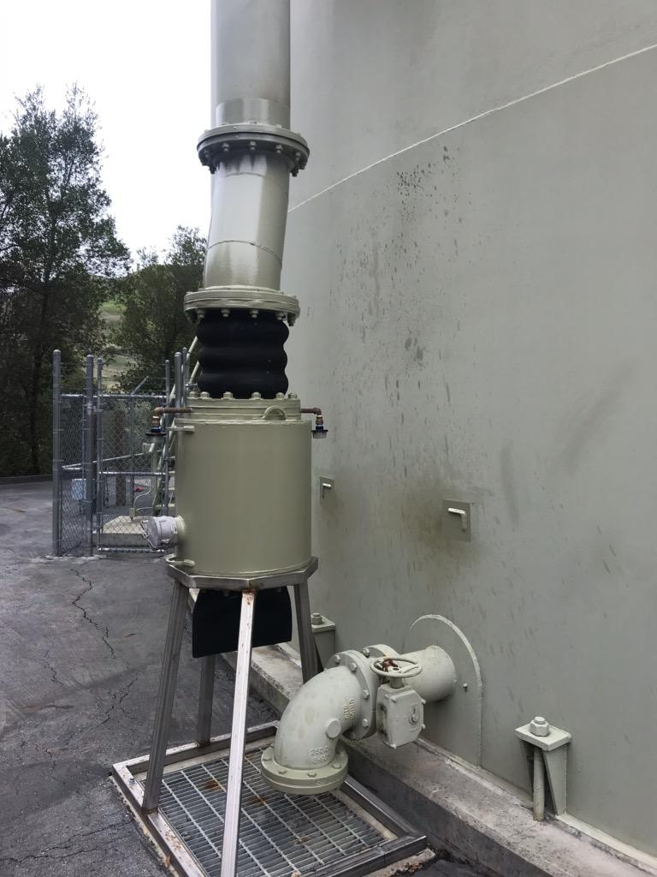
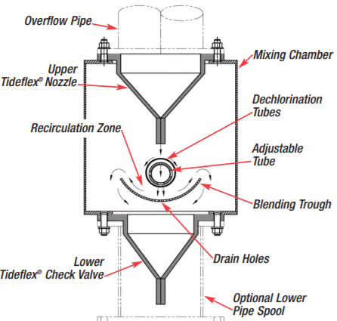
Tank Overflows
Retrofitted tank overflows to include air gaps and dechlorination

Slide 6
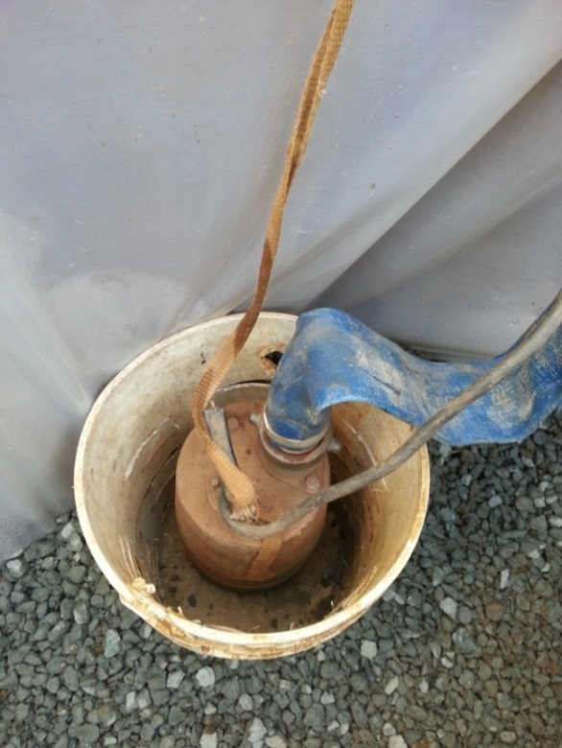
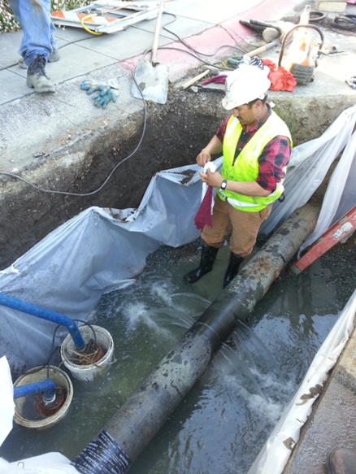
Trench Dewatering - I
Gravel lining at bottom of trench
Trash pump in perforated plastic bucket
Plastic lining of trench walls

Slide 7
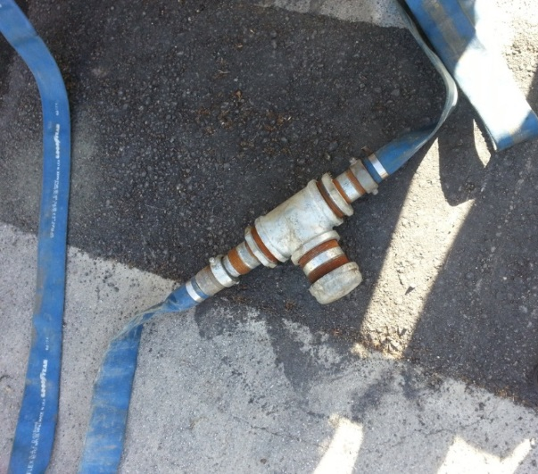
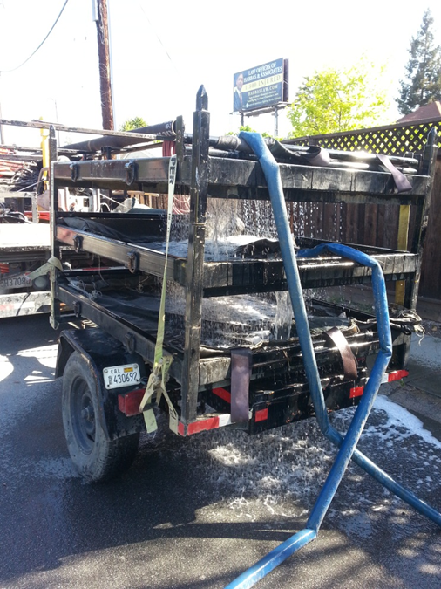
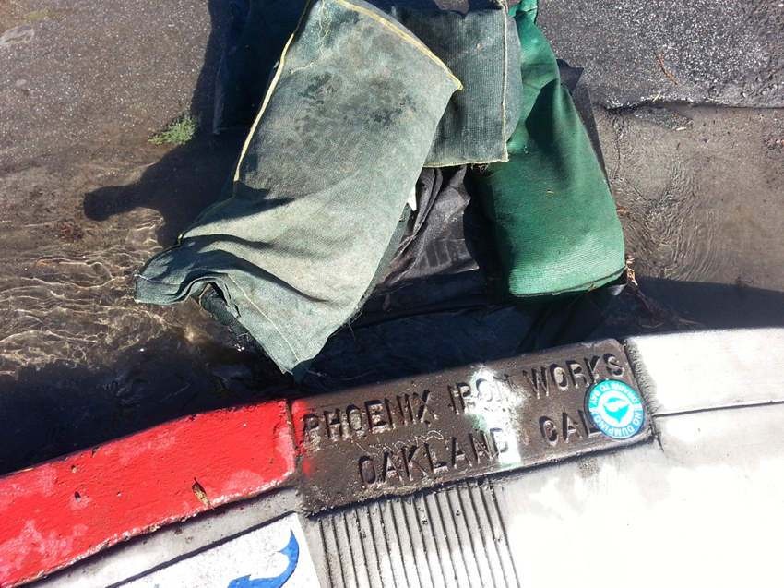
Trench Dewatering - II
In line dechlorination
Filter bags trailer
Gravel Bags with protective fabric over the inlet

Slide 8
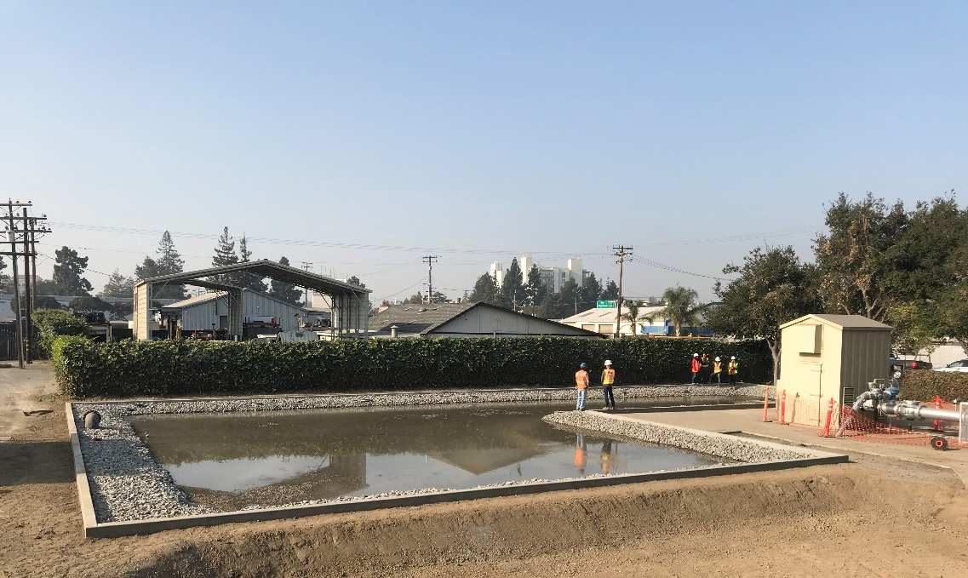
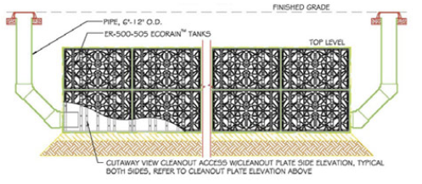
Well Blowoffs (flushing)
Constructed percolating and filtering sumps
Avoids direct discharges
Uses storm drains and existing energy diffusion structures
Most of the flushing is captured as beneficial reuse

Slide 9
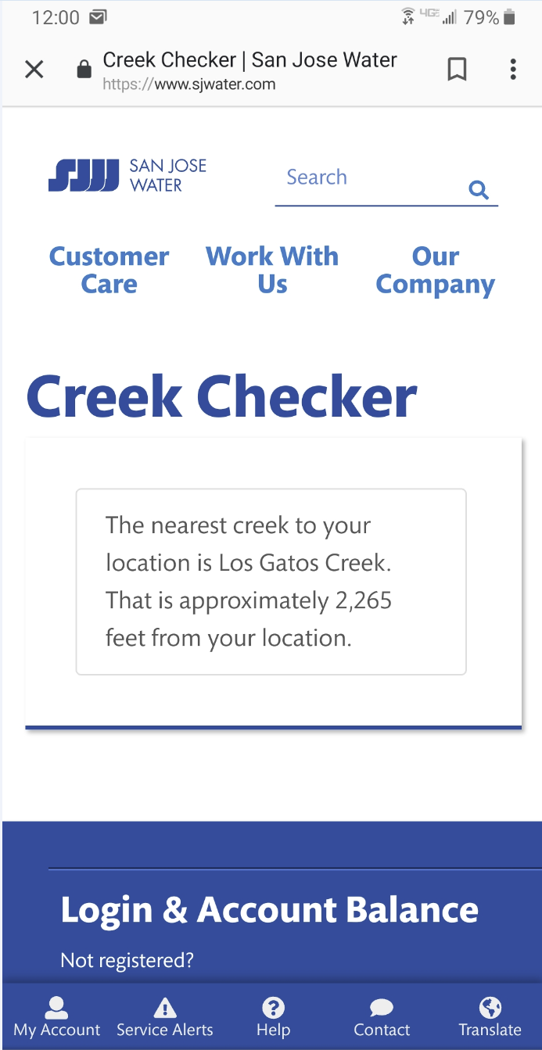
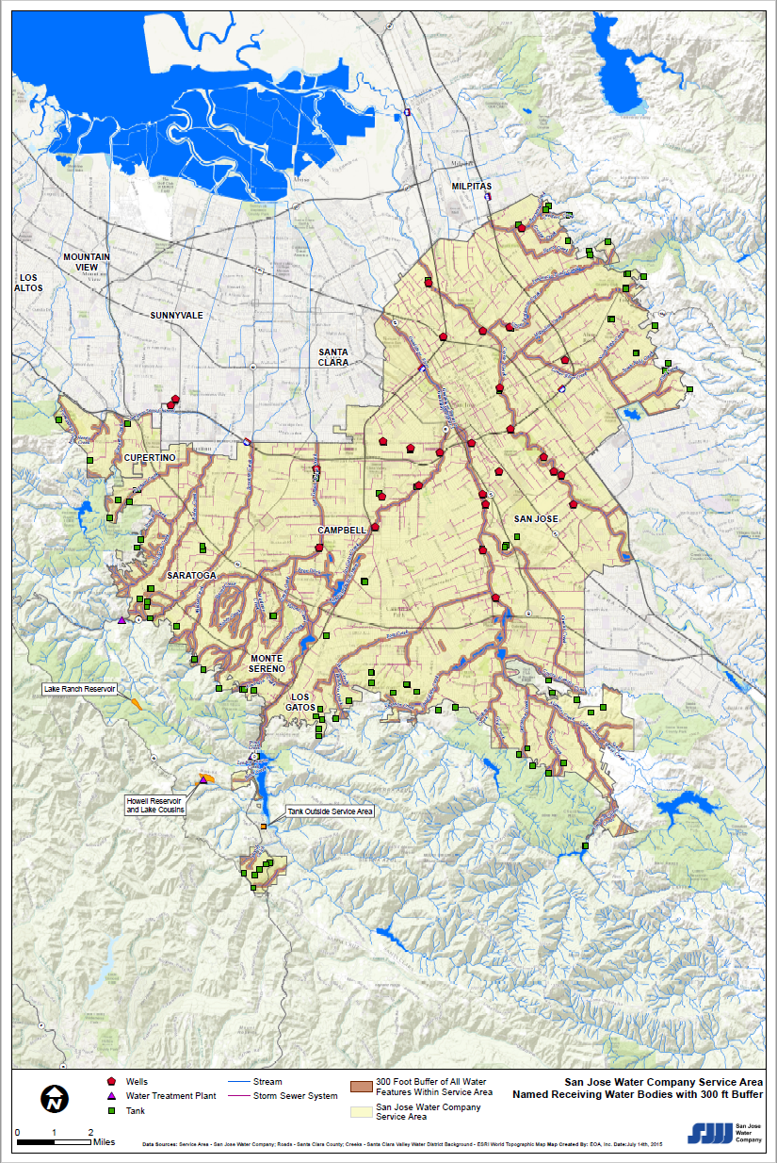
Distance from WOTUS
Developed an App to estimate distance from discharge point
Distance from WOTUS triggers field surveys for unplanned discharges
Used map developed for filing NOI

Slide 10
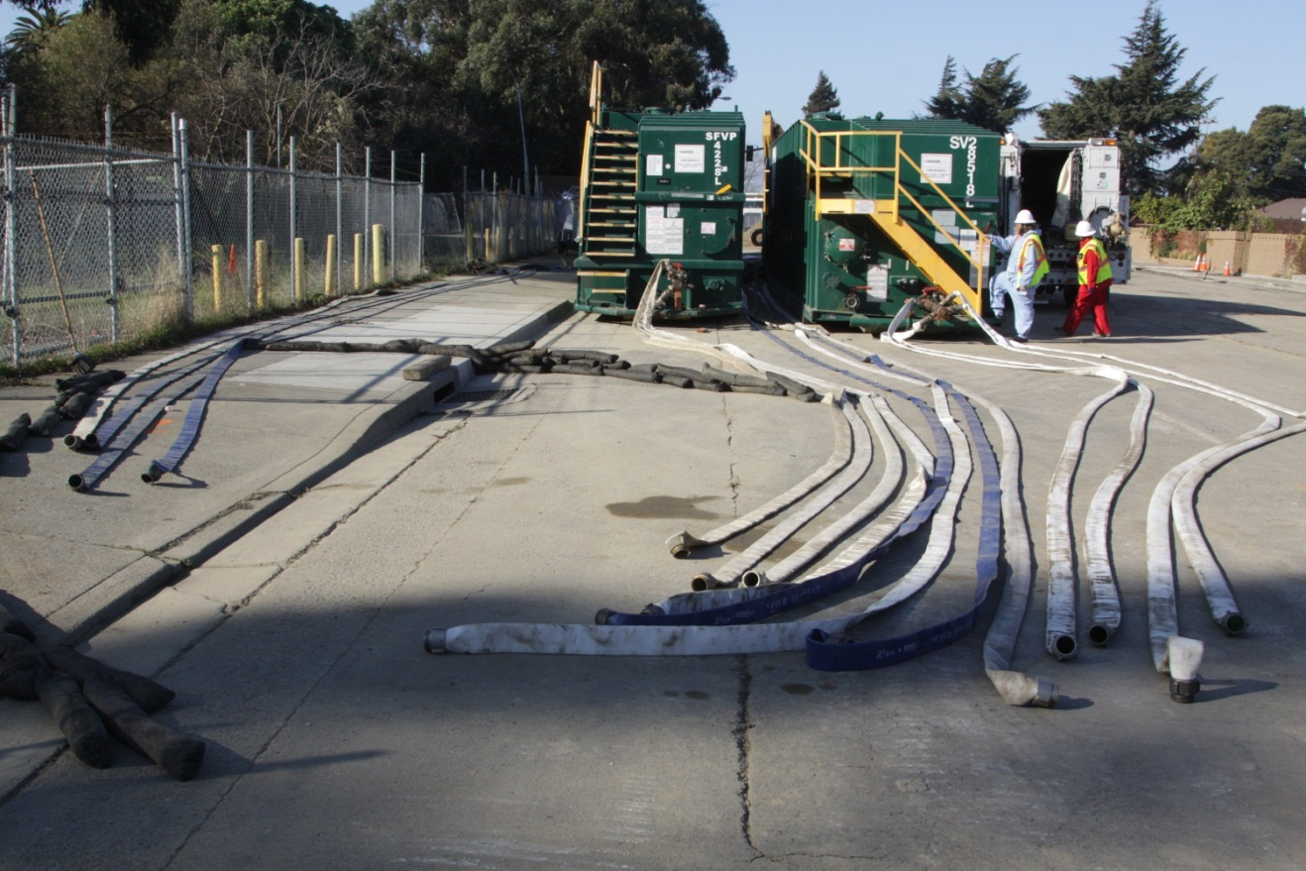
Superchlorinated Discharges
Tanks for dechlorinating superchlorinated water
Picture courtesy of EBMUD

Slide 11
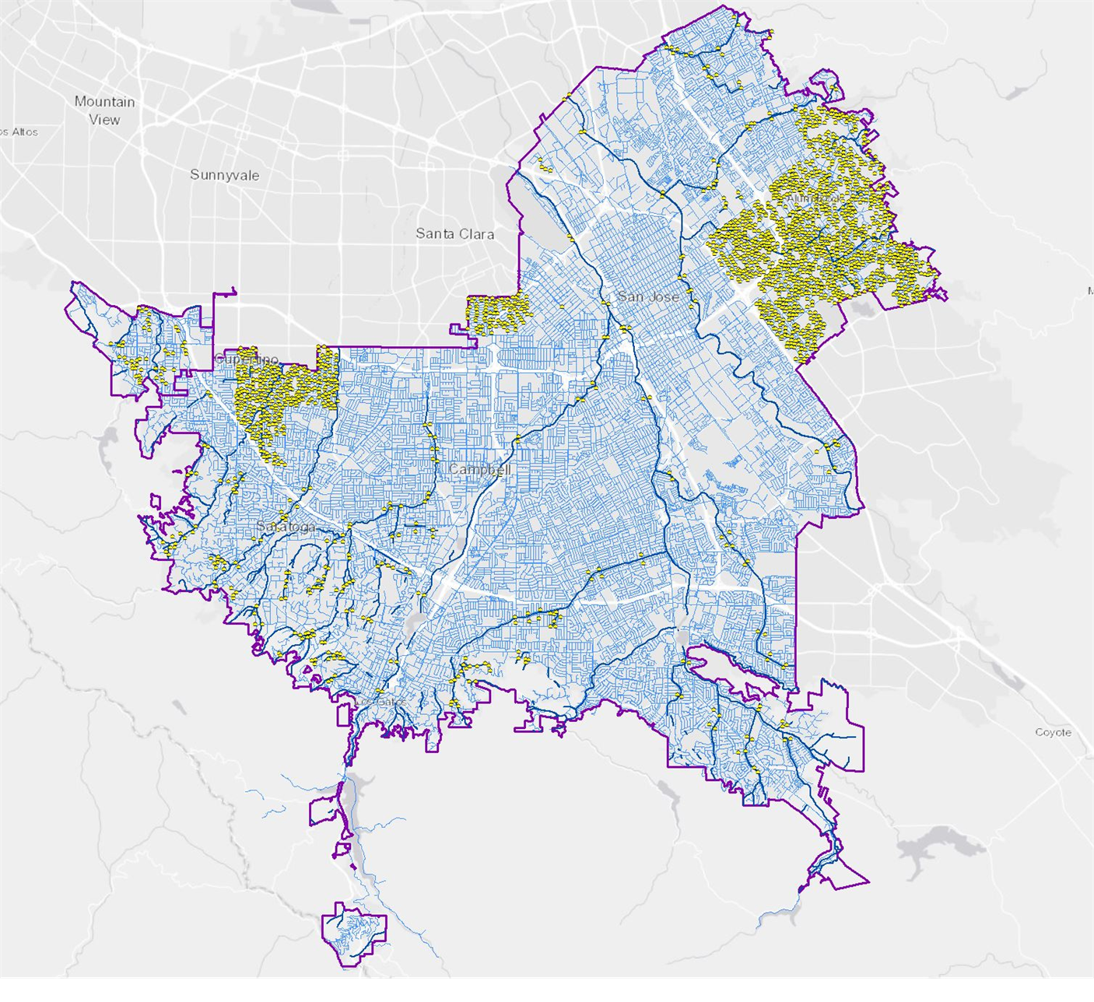
Leak Detection
Improve Level of Service for SJW Strategic Building Blocks
Improve System Efficiency and Integrity
Exercise Prudent Business Practice as Value of Water Increases
Reduce Risk to Water Quality
Reduce Real Water Losses
Reduce Liability Costs

Slide 12
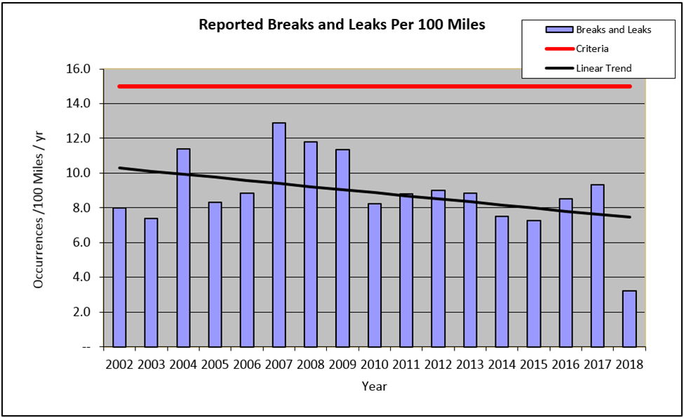
Prioritization of Main Replacement
Incorporated proximity of mains to WOTUS in the Main Prioritization Algorithm
First six months for 2018

Slide 13
Operational Changes at Cal Water
Implemented Discharge Management Plans
Performed staff training
Developed database management system
BMP improvements

Slide 14
Discharge Management Plans
Discharge Record Form
Quick Reference
Operators Discharge Decision Flow Chart

Slide 15
Discharge Record Form

Slide 16
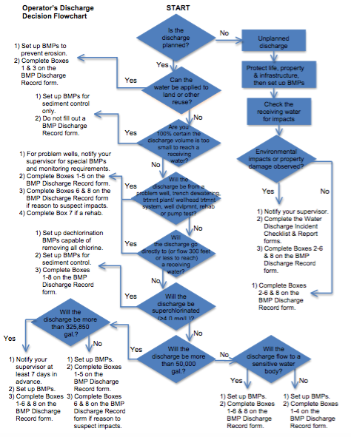
Discharge Guidance Flowchart

Slide 17
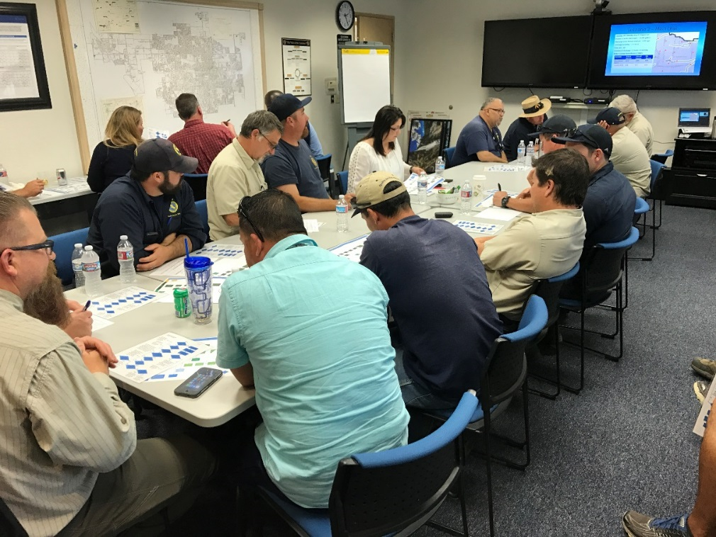
Evolution of Discharge Management Training
Classroom Lecture
Hands on training
Scenario based training

Slide 18
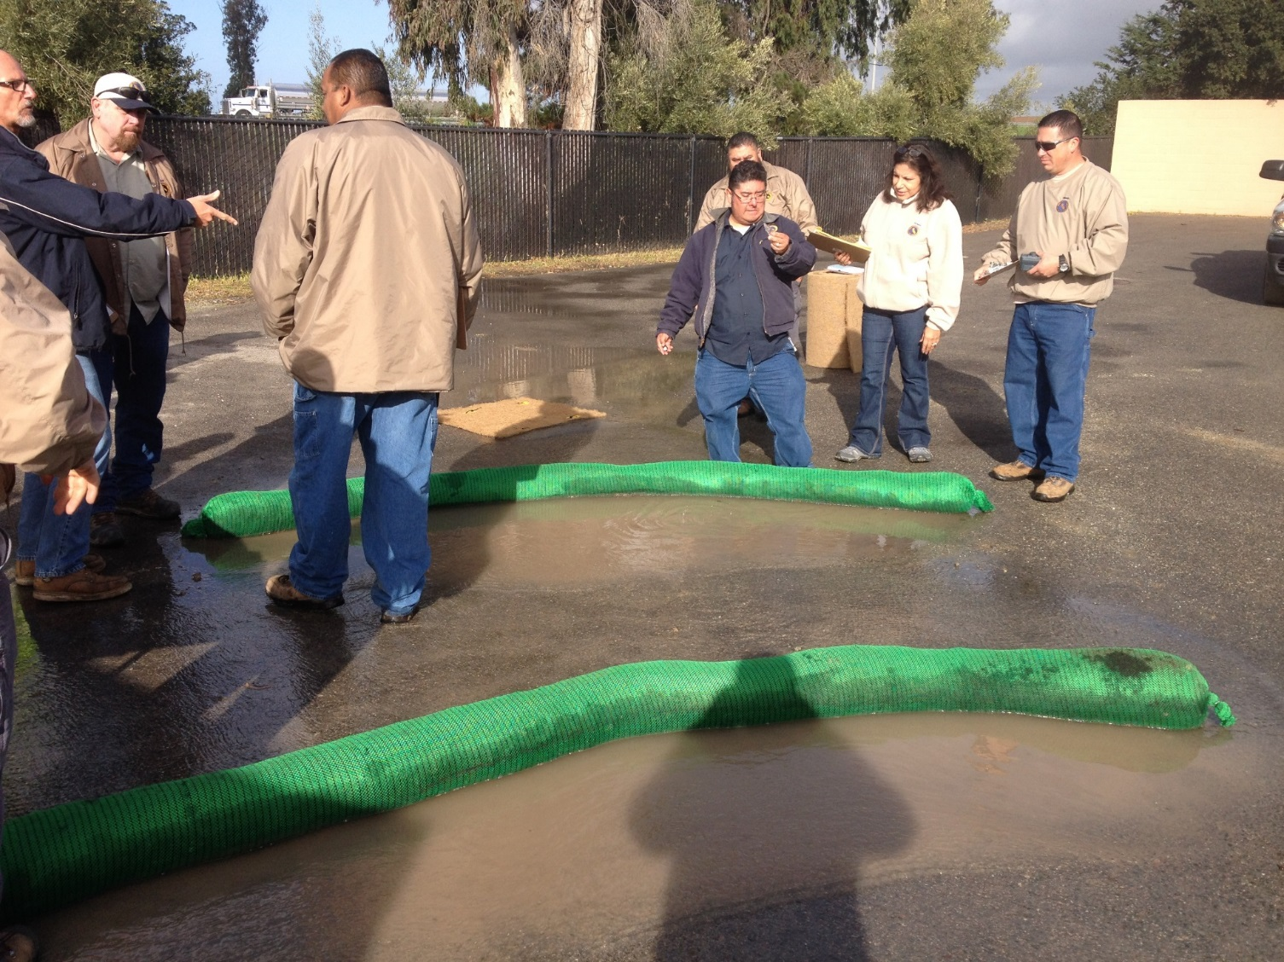
Hands on Training

Slide 19
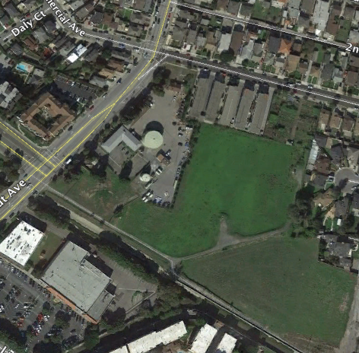
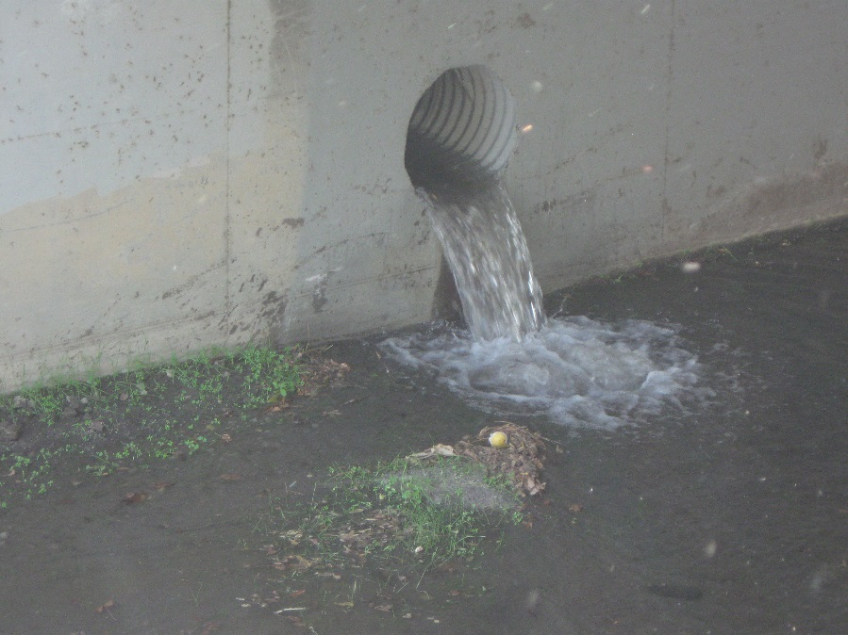
Scenario Based Training
Location: South San Francisco
420, 000 gallons discharged
No possible to discharge to land
Discharge total chlorine residual = 0.0 mg/L
Discharge turbidity = 15 NTU
Flow rate = 700 GPM
Duration of discharge = 10 hours

Slide 20
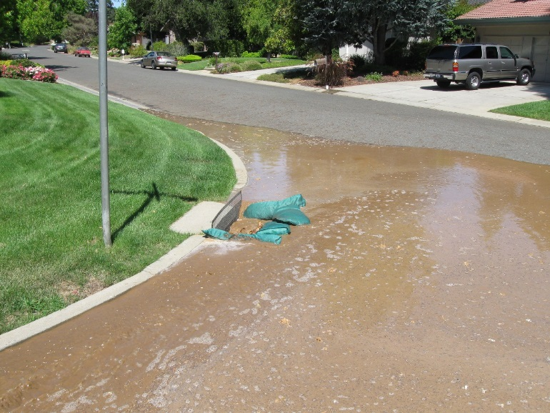
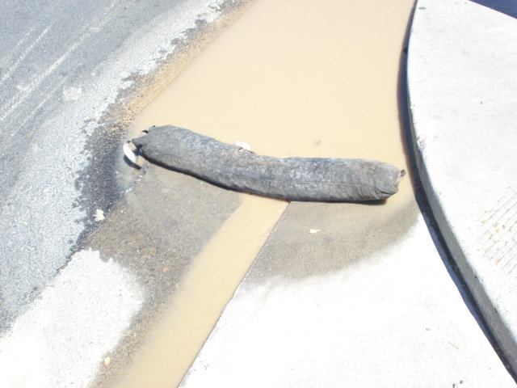
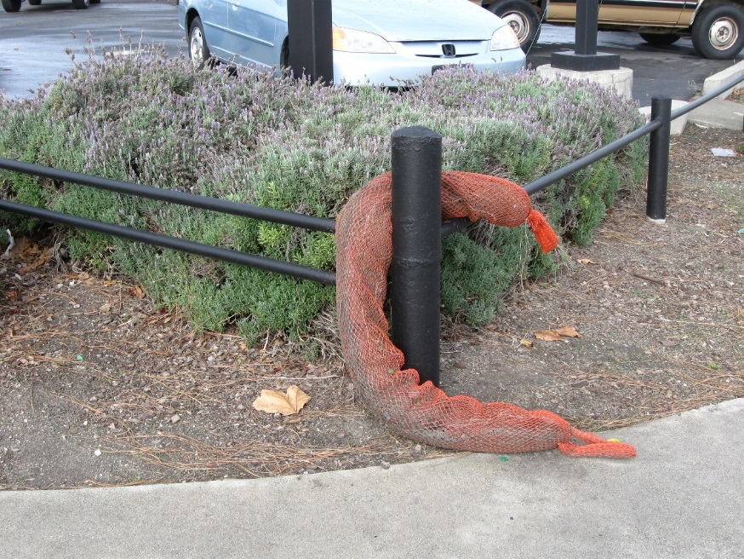
BMP Improvements

Slide 21
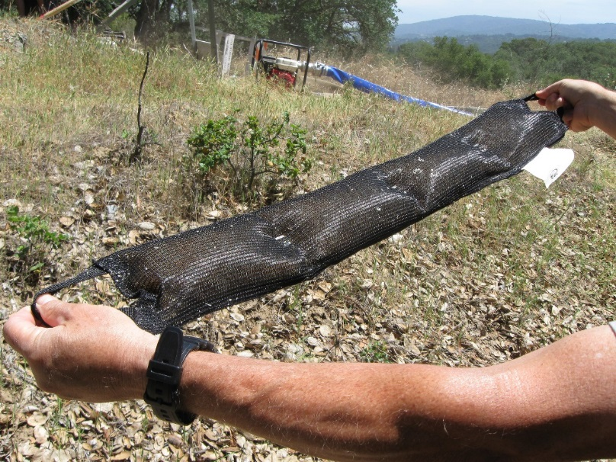
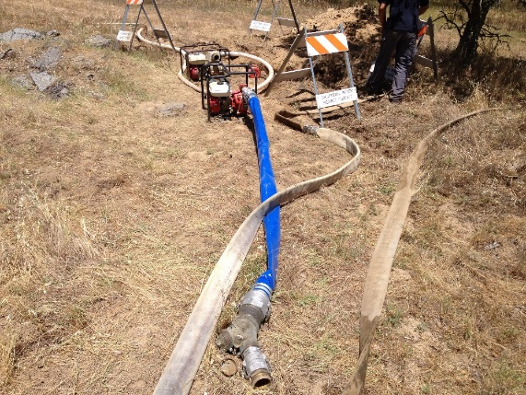
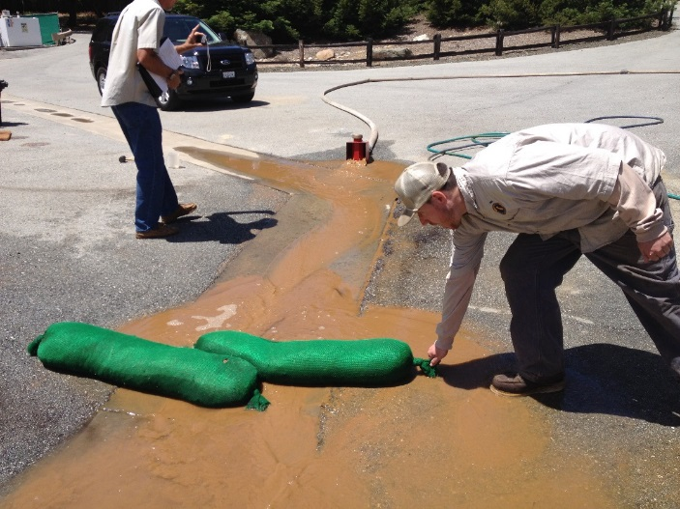
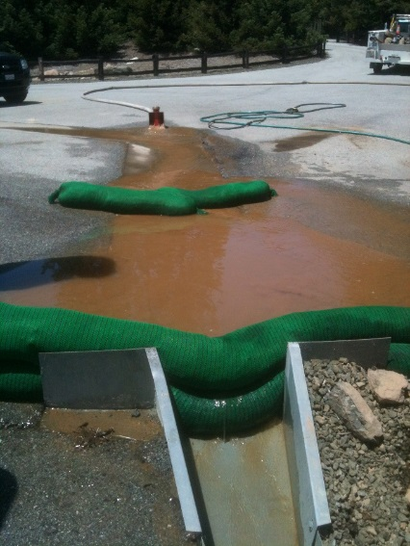
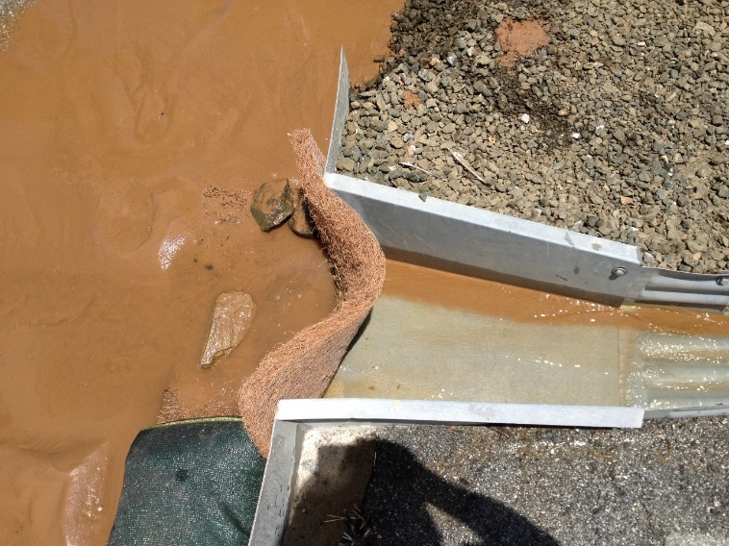
BMP Improvements

Slide 22
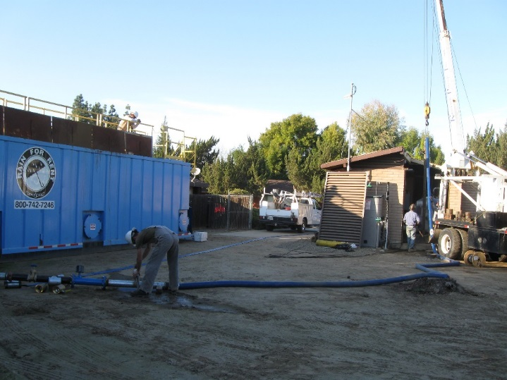
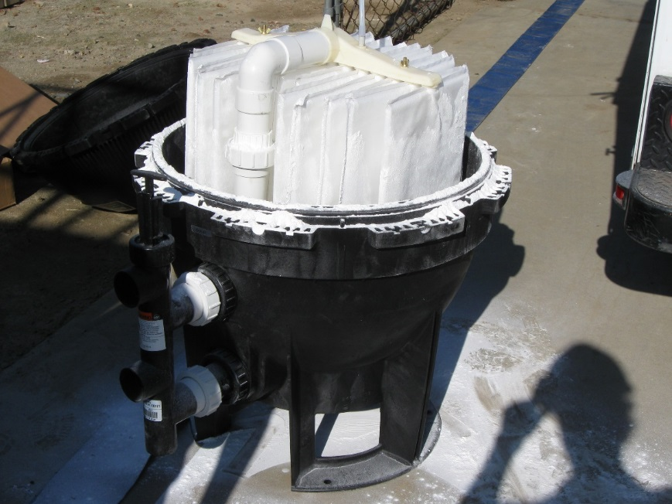
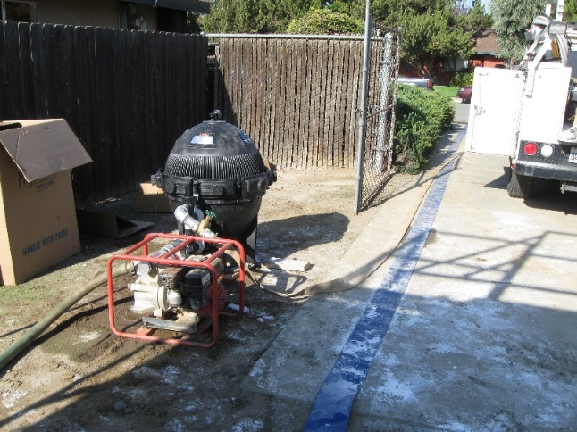
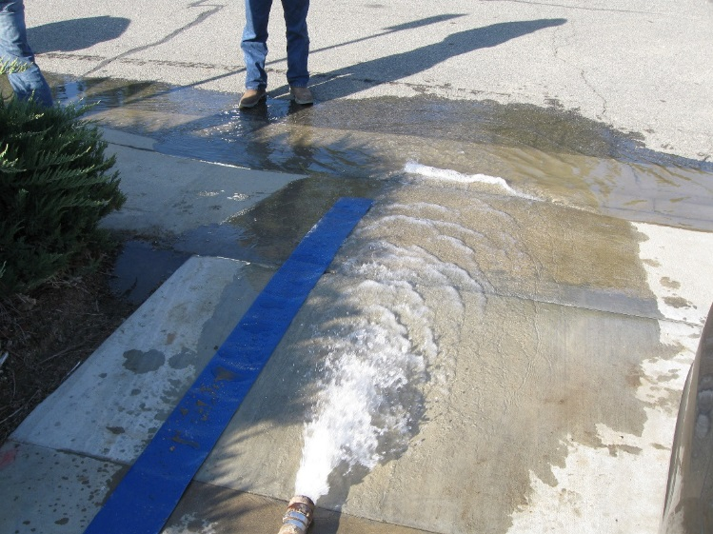
BMP Improvements

Slide 23
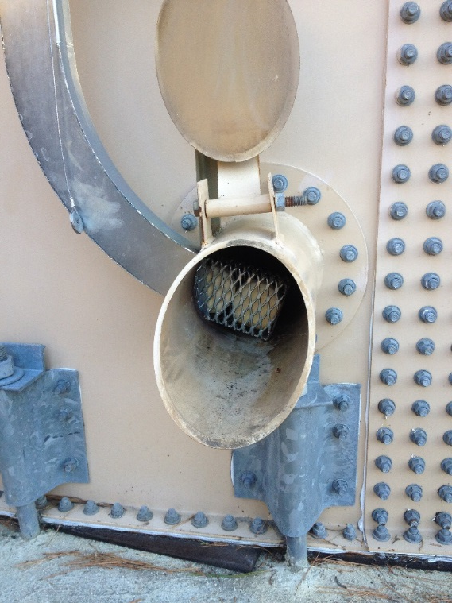
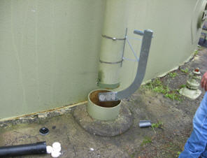
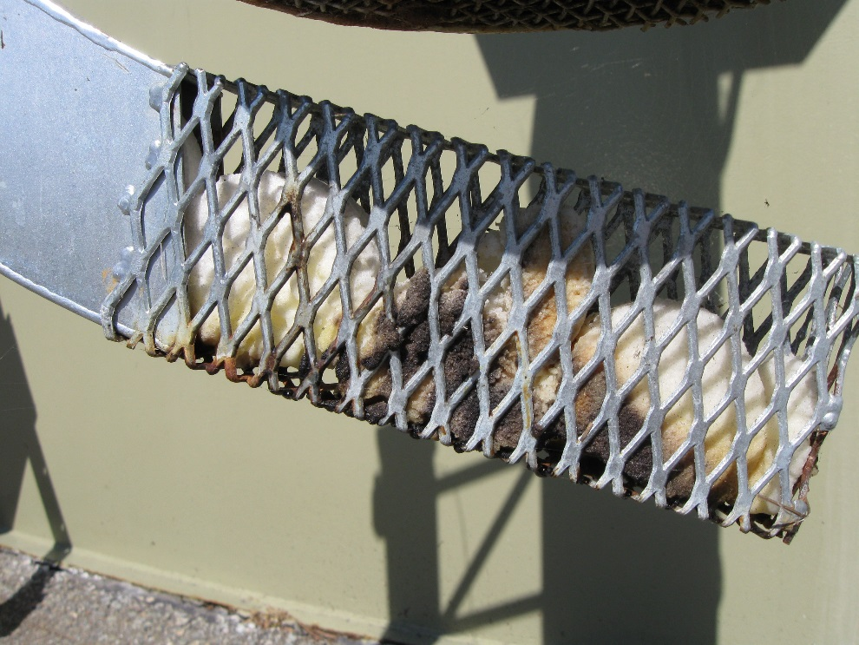
BMP Improvements

Slide 24
Status of BMPs Manual Update
Workgroup established & kick-off meeting June 26, 2018
First draft released January 12, 2018
First draft comments received February 11, 2019
Second draft scheduled for release April 9, 2019
Finalize manual end of June 2019

